Slide 1
Combinatorics
Rosen 6th ed., §5.1-5.3, § 5.5
Notes:
Discrete Mathematics and its Applications
(c)2001-2002, Michael P. Frank

Slide 2
Combinatorics
Count the number of ways to put things together into various combinations.
  e.g. If a password is 6-8 letters and/or digits, how many passwords can there be?
Two main rules:
  Sum rule
  Product rule
Notes:
Discrete Mathematics and its Applications
(c)2001-2002, Michael P. Frank

Slide 3
Sum Rule
Let us consider two tasks:
  m is the number of ways to do task 1
  n is the number of ways to do task 2
  Tasks are independent of each other, i.e.,
    Performing task 1 does not accomplish task 2 and vice versa.
Sum rule: the number of ways that “either task 1 or task 2 can be done, but not both”, is m+n.
Generalizes to multiple tasks ...
Notes:
Discrete Mathematics and its Applications
(c)2001-2002, Michael P. Frank

Slide 4
Example
A student can choose a computer project from one of three lists. The three lists contain 23, 15, and 19 possible projects respectively. How many possible projects are there to choose from?
Notes:
Discrete Mathematics and its Applications
(c)2001-2002, Michael P. Frank

Slide 5
Set Theoretic Version
If A is the set of ways to do task 1, and B the set of ways to do task 2, and if A and B are disjoint, then:
“the ways to do either task 1 or 2 are
A∪B, and |A∪B|=|A|+|B|”
Notes:
Discrete Mathematics and its Applications
(c)2001-2002, Michael P. Frank

Slide 6
Product Rule
Let us consider two tasks:
  m is the number of ways to do task 1
  n is the number of ways to do task 2
  Tasks are independent of each other, i.e.,
    Performing task 1does not accomplish task 2 and vice versa.
Product rule: the number of ways that “both tasks 1 and 2 can be done” in mn.
Generalizes to multiple tasks ...
Notes:
Discrete Mathematics and its Applications
(c)2001-2002, Michael P. Frank

Slide 7
Example
The chairs of an auditorium are to be labeled with a letter and a positive integer not to exceed 100. What is the largest number of chairs that can be labeled differently?
Notes:
Discrete Mathematics and its Applications
(c)2001-2002, Michael P. Frank

Slide 8
Set Theoretic Version
If A is the set of ways to do task 1, and B the set of ways to do task 2, and if A and B are disjoint, then:
The ways to do both task 1 and 2 can be represented as A×B, and |A×B|=|A|·|B|
Notes:
Discrete Mathematics and its Applications
(c)2001-2002, Michael P. Frank

Slide 9
More Examples
How many different bit strings are there of length seven?
Notes:
Discrete Mathematics and its Applications
(c)2001-2002, Michael P. Frank

Slide 10
More Examples
Suppose that either a member of the CS faculty or a student who is a CS major can be on a university committee. How many different choices are there if there are 37 CS faculty and 83 CS majors ?
Notes:
Discrete Mathematics and its Applications
(c)2001-2002, Michael P. Frank

Slide 11
More Examples
How many different license plates are available if each plate contains a sequence of three letters followed by three digits?
Notes:
Discrete Mathematics and its Applications
(c)2001-2002, Michael P. Frank

Slide 12
Example Using Both Rules
Each user on a computer system has a password, which is six to eight characters long where each character is an uppercase letter or a digit. Each password must contain at least one digit. How many possible passwords are there?
Notes:
Discrete Mathematics and its Applications
(c)2001-2002, Michael P. Frank

Slide 13
Permutations
A permutation of a set S of objects is an ordered arrangement of the elements of S where each element appears only once:
e.g., 1 2 3, 2 1 3, 3 1 2
An ordered arrangement of r distinct elements of S is called an r-permutation.
The number of r-permutations of a set S with n=|S| elements is
P(n,r) = n(n−1)…(n−r+1) = n!/(n−r)!
Notes:
Discrete Mathematics and its Applications
(c)2001-2002, Michael P. Frank

Slide 14
Example
How many ways are there to select a third-prize winner from 100 different people who have entered a contest?
Notes:
Discrete Mathematics and its Applications
(c)2001-2002, Michael P. Frank

Slide 15
More Examples
A terrorist has planted an armed nuclear bomb in your city, and it is your job to disable it by cutting wires to the trigger device.
There are 10 wires to the device.
If you cut exactly the right three wires, in exactly the right order, you will disable the bomb, otherwise it will explode!
If the wires all look the same, what are your chances of survival?
P(10,3) = 10·9·8 = 720,
so there is a 1 in 720 chance that you’ll survive!
Notes:
Discrete Mathematics and its Applications
(c)2001-2002, Michael P. Frank

Slide 16
More Examples
How many permutations of the letters ABCDEFG contain the string ABC?
Notes:
Discrete Mathematics and its Applications
(c)2001-2002, Michael P. Frank

Slide 17
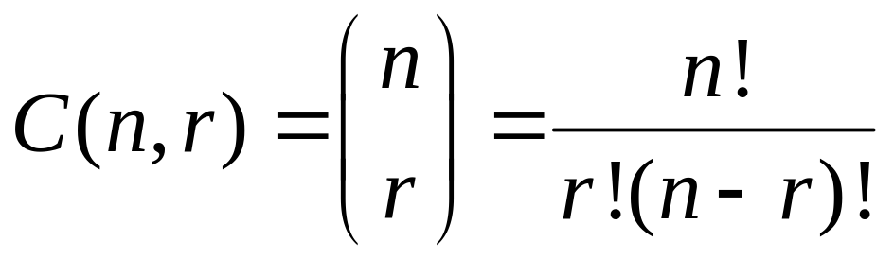
Combinations
The number of ways of choosing r elements from S (order does not matter).
S={1,2,3}
e.g., 1 2 , 1 3, 2 3
The number of r-combinations C(n,r) of a set with n=|S| elements is
Notes:
Discrete Mathematics and its Applications
(c)2001-2002, Michael P. Frank

Slide 18
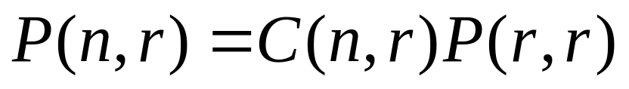
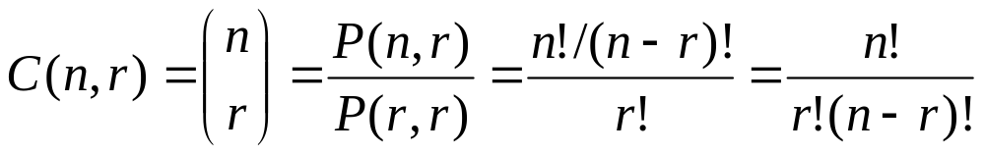
Combinations vs Permutations
Essentially unordered permutations …
Note that C(n,r) = C(n, n−r)
Notes:
Discrete Mathematics and its Applications
(c)2001-2002, Michael P. Frank

Slide 19
Combination Example
How many distinct 7-card hands can be drawn from a standard 52-card deck?
  The order of cards in a hand doesn’t matter.
Answer C(52,7) = P(52,7)/P(7,7)
= 52·51·50·49·48·47·46 / 7·6·5·4·3·2·1
17
10
7
8
2
52·17·10·7·47·46 = 133,784,560
Notes:
Discrete Mathematics and its Applications
(c)2001-2002, Michael P. Frank

Slide 20
More Examples
How many ways are there to select a committee to develop a discrete mathematics course if the committee is to consist of 3 faculty members from the Math department and 4 from the CS department, if there are 9 faculty members from Math and 11 from CS?
Notes:
Discrete Mathematics and its Applications
(c)2001-2002, Michael P. Frank

Slide 21
Example
How many strings of length eight either start with a 1 bit or end with the two bit string 00?
Notes:
Discrete Mathematics and its Applications
(c)2001-2002, Michael P. Frank

Slide 22
Generalized
Permutations and Combinations
How to solve counting problems where elements may be used more than once?
How to solve counting problems in which some elements are not distinguishable?
How to solve problems involving counting the ways we to place distinguishable elements in distinguishable boxes?
Notes:
Discrete Mathematics and its Applications
(c)2001-2002, Michael P. Frank

Slide 23



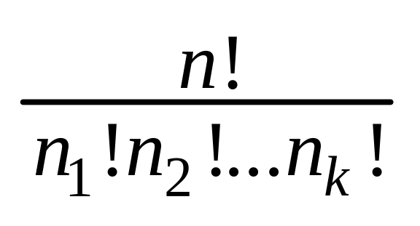



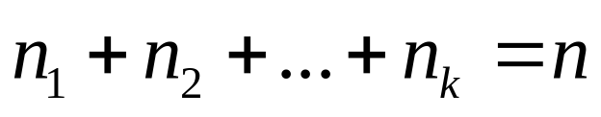
Permutations with non-distinguishable objects
The number of different permutations of n objects, where there are non-distinguishable objects of type 1, non-distinguishable objects of type 2, …, and non-distinguishable objects of type k, is
i.e., C(n, )C(n- , )…C(n- - -…- , )
Notes:
Discrete Mathematics and its Applications
(c)2001-2002, Michael P. Frank

Slide 24

Permutations with Repetition
The number of r-permutations of a set of n objects with repetition allowed is
Example: How many strings of length n can be formed from the English alphabet?
Notes:
Discrete Mathematics and its Applications
(c)2001-2002, Michael P. Frank

Slide 25
Permutations with non-distinguishable objects
Example: How many different strings can be made by reordering the letters of the word
SUCCESS
Notes:
Discrete Mathematics and its Applications
(c)2001-2002, Michael P. Frank

Slide 26
Thank You

Slide 27
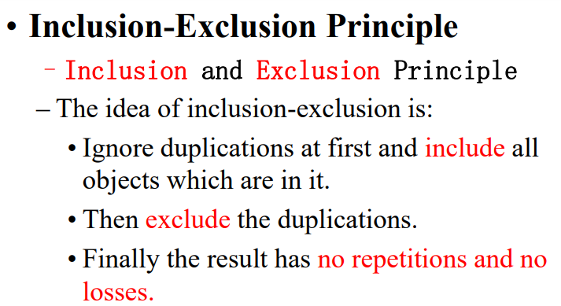
Inclusion-Exclusion Principle

Slide 28
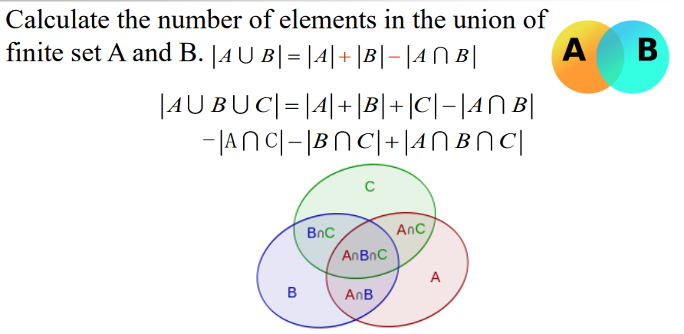

Slide 29
Inclusion-Exclusion Principle
(relates to the “sum rule”)
Suppose that k≤m of the ways of doing task 1 also simultaneously accomplishes task 2. (And thus are also ways of doing task 2.)
Then the number of ways to accomplish “Do either task 1 or task 2” is m+n−k.
Set theory: If A and B are not disjoint, then |A∪B|=|A|+|B|−|A∩B|.
Notes:
Discrete Mathematics and its Applications
(c)2001-2002, Michael P. Frank

Slide 30
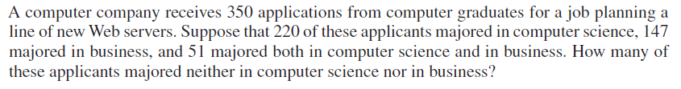

Slide 31
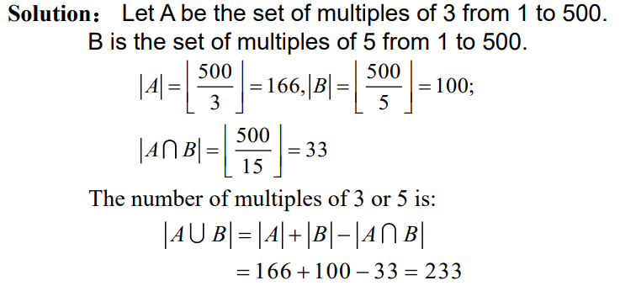
Example

Slide 32
Example
Find the total number of integers lying between 1 and 1000 that are divisible by at least one of 2,3 and 7.

Slide 33
Pigeonhole Principle

Slide 34
Pigeonhole Principle
Notes:
Discrete Mathematics and its Applications
(c)2001-2002, Michael P. Frank

Slide 35
Example
How many students must be in class to guarantee that at least two students receive the same score on the final exam, if the exam is graded on a scale from 0 to 100 points?
Notes:
Discrete Mathematics and its Applications
(c)2001-2002, Michael P. Frank

Slide 36
Generalized Pigeonhole Principle
If n pigeonholes are occupied by kn+1 or more pigeons (k is a positive integer) then at least one pigeonhole is occupied by k+1 or more pigeons.
Notes:
Discrete Mathematics and its Applications
(c)2001-2002, Michael P. Frank

Slide 37
Generalized Pigeonhole Principle
If N≥k+1 objects are assigned to k places, then at least one place must be assigned at least ⎡N/k⎤ objects.
e.g., there are N=280 students in this class. There are k=52 weeks in the year.
  Therefore, there must be at least 1 week during which at least ⎡280/52⎤= ⎡5.38⎤=6 students in the class have a birthday.
Notes:
Discrete Mathematics and its Applications
(c)2001-2002, Michael P. Frank

Slide 38
G.P.P. Example
Given: There are 280 students in the class. Without knowing anybody’s birthday, what is the largest value of n for which we can prove that at least n students must have been born in the same month?
Answer:
⎡280/12⎤ = ⎡23.3⎤ = 24
Notes:
Discrete Mathematics and its Applications
(c)2001-2002, Michael P. Frank

Slide 39
More Examples
What is the minimum number of students required in a discrete math class to be sure that at least six will receive the same grade, if there are five possible grades, A, B, C, D, and F?
Notes:
Discrete Mathematics and its Applications
(c)2001-2002, Michael P. Frank

Slide 40
More Examples
What is the minimum number of students required to be sure that at five of them will be in the same class ( 1st yr, 2nd yr, 3rd yr, and 4th yr)
Notes:
Discrete Mathematics and its Applications
(c)2001-2002, Michael P. Frank

Slide 41
More Example
Show that at least two women will be next to each other if three men and five women are lined up in a row.

Slide 42
More Example
A bag contains beads of two colours: black and white. What is the smallest number of beads which must be drawn from the bag, without looking so that among these beads, two are of the same colour?

Slide 43
More Example
Find the minimum number of students in a class such that three of them are born in the same month?

Slide 44
More Example
There are 13 squares of side 1 positioned inside a circle of radius 2. Show that at least 2 of the squares have a common point.

Slide 45
Thank You

